Slide 1

An Apple A Day Keeps Pagoda Upway
Ruiyang Ge · Zichao Xiong · Le Yang · Cheng Yi · Wenhao Zhang · Yuyang Zhang

Slide 2







Market
Direct Method
Relative Method
Conclusion
IPO at HKEX
Mobile APP and fruit e-commerce
400 million in financing
Launch online shop
First store in Shenzhen
2023
Establish in Shenzhen
2016
2015
2008
2002
2001

Slide 3
Market
Direct Method
Relative Method
Conclusion
22
140
Provinces and regions
Cities
5650
1st
Stores
Rank in fruit retailer

Slide 4





Market
Direct Method
Relative Method
Conclusion
Bases around the World
Preferred Varieties
Scientific Harvesting Technique
Cold Chain Preservation
Strict Standard
Ensure fruit quality from the source
Selected varieties, careful breeding
Maturity management and timely harvest
Cold chain control and comprehensive freshness management
Strictly implement the five operation standard systems

Slide 5
Market
Direct Method
Relative Method
Conclusion
Pagoda continues to grow

Slide 6
Market
Direct Method
Relative Method
Conclusion

Slide 7
Market
Direct Method
Relative Method
Conclusion
The expected lower growth rate is 4.13%, because:
The annual growth of average fruit consumption is -2% to 8%;
Until 2030, the average fruit consumption will exceed the lower limit of 73kg as suggested by Dietary Guidelines for Chinese Residents.
Why is 4% a lower estimated growth rate?
No price increase;
No variety change;
No quality upgrade …

Slide 8
Market
Direct Method
Relative Method
Conclusion

Slide 9
Market
Direct Method
Relative Method
Conclusion
The expected medium growth rate is 7.68%, because:
The total retail sales of fruit is growing at this rate;
We suppose that Pagoda will not outperform the market (i.e. no market share growth, no leading advantages);
Also Pagoda will not be worse (i.e. no scandal, no commercial dispute).

Slide 10
Market
Direct Method
Relative Method
Conclusion

Slide 11
Market
Direct Method
Relative Method
Conclusion
Top Five Fruit Retailers
Rank | Corporation | Fruit Retail Sales (Billion Yuan) | Market Share | Number of Stores
1 | Pagoda | 12.7 | 1.0% | 5,650
2 | A | 10.8 | 0.9% | 4,320
3 | B | 8.5 | 0.7% | 1,065
4 | C | 7.7 | 0.6% | 4,313
5 | D | 5.2 | 0.4% | 302

Slide 12
Market
Direct Method
Relative Method
Conclusion
The expected high growth rate is 12.72%, because:
From 2019 to 2022 H1, the compound annual growth rate of store expansion was 7.52%;
The average single-store fruit retail sales growth rate from 2020 to 2021 is 4.84%；
We assume that store expansion and single-store sales can maintain this good growth rate: (1.0752*1.0484-1)*100%=12.72%

Slide 13
Market
Direct Method
Relative Method
Conclusion
Fruit sales: We believe that the company is based on the advantages of scale, brand, point and other advantages in the fruit retail industry, the company has built a significant competitive barrier in the middle and high-end fruit retail industry, and the fruit sales are expected to continue to grow.
We expect the company's franchise stores to maintain steady same-store growth thanks to enhanced operating capacity in different regions, and our sales revenue to continue to grow. In addition, the company will continue to expand its sales channels and coverage.
We expect that in the future, the sales scale of fruit direct selling channels and the sales scale of online channels will grow at a high speed, and other channels will maintain a relatively stable growth rate.
The company continues to expand the layout of the warehouse distribution center in the country, the scale advantage continues to enlarge, to ensure product quality while reducing costs and increasing efficiency.
At the same time, thanks to the continuous strengthening of the company's end-to-end supply capacity, it is expected that in the future, the sales proportion of A-brand fruits with high gross profit margin will continue to increase, to further improve profitability.

Slide 14
Market
Direct Method
Relative Method
Conclusion
Revenue forecast for the company's fruit sales channel(million)
 | 2021 | 2022 | 2023E | 2024E | 2025E | 2026E | 2027E
Franchised stores (direct management) | 8125 | 8851 | 10066 | 11391 | 12856 | 14484 | 16319
YoY |  | 8.9% | 13.7% | 13.2% | 12.9% | 13.0% | 13.0%
Single-store contribution (10,000 yuan/room/year) | 191 | 193 | 198 | 202 | 207 | 211 | 216
YoY |  | 1.3% | 2.5% | 2.3% | 2.3% | 2.1% | 2.1%
Number of franchised stores (direct management) | 4254 | 4586 | 5088 | 5629 | 6210 | 6852 | 7562
YoY |  | 7.8% | 11.0% | 10.6% | 10.3% | 10.4% | 10.4%
Franchised stores (consignment management) | 970 | 1073 | 1268 | 1487 | 1742 | 2021 | 2344
YoY |  | 11% | 18% | 17% | 17% | 16% | 16%
Single-store contribution (10,000 yuan/room/year) | 99 | 102 | 105 | 109 | 113 | 117 | 121
YoY |  | 2.8% | 3.5% | 3.5% | 3.5% | 3.3% | 3.3%
Number of franchised stores (consignment management) | 980 | 1052 | 1208 | 1364 | 1542 | 1731 | 1944
YoY |  | 7.4% | 14.8% | 13.0% | 13.0% | 12.3% | 12.3%
Direct selling | 523 | 724 | 1122 | 1627 | 2196 | 2855 | 3654
YoY |  | 38% | 55% | 45% | 35% | 30% | 28%
Online channels | 326 | 273 | 341 | 436 | 567 | 737 | 958
YoY |  | -16% | 25% | 28% | 30% | 30% | 30%
Others | 48 | 61 | 78 | 97 | 121 | 151 | 189
YoY |  | 26% | 27% | 25% | 24% | 25% | 25%
Overall Revenue forecast for the company's fruit sales channel | 9992 | 10982 | 12875 | 15037.73 | 17481.68 | 20248 | 23465
YoY |  | 10% | 17% | 17% | 16% | 16% | 16%
COGS | 9133 | 9998 | 11648 | 13584 | 15788 | 18314 | 21244
YoY |  | 9% | 17% | 17% | 16% | 16% | 16%
Gross profit | 859 | 984 | 1227 | 1453.731 | 1693.684 | 1934 | 2221
YoY |  | 15% | 25% | 18% | 17% | 14% | 15%
Gross margin | 8.60% | 8.96% | 9.53% | 9.67% | 9.69% | 9.55% | 9.46%

Slide 15
Market
Direct Method
Relative Method
Conclusion
Royalties and franchise income:
The company adopts the business model of franchise, usually charging royalties to franchise stores and regional agents in a certain proportion, and charging a fixed franchise fee to new franchise stores.
We expect future royalty rates and franchise revenue to continue to grow as the number of franchise stores increases.
Miscellaneous receipt:
Other income of the company includes membership income, etc. We expect the growth rate of the other revenue would go down as the company continues to expand its customer base.
Concession use and franchise revenue(million)
 | 2021 | 2022 | 2023E | 2024E | 2025E | 2026E | 2027E
Revenue | 160 | 168 | 192 | 218 | 250 | 283 | 319
YoY |  | 5% | 14% | 14% | 15% | 13% | 13%
Gross profit | 160 | 168 | 192 | 218 | 250 | 283 | 319
Other revenue(million)
Revenue | 137 | 161 | 193 | 224 | 257 | 293 | 334
YoY |  | 18% | 20% | 16% | 15% | 14% | 14%
Gross profit | 137 | 161 | 193 | 224 | 257 | 293 | 334

Slide 16
Market
Direct Method
Relative Method
Conclusion
Assumptions about expenses, interest receipts and expenditures, taxes
Scale of charges:
In terms of sales expense ratio, as the company will continue to expand more sales areas in the future and further develop online sales and direct sales channels, we expect the company's sales expense ratio to increase slightly in the future.
In terms of management expense ratio, the company has continuously improved management efficiency in recent years; meanwhile, with the increase of operation scale, management expenses will be continuously diluted. We expect the company's management expense ratio to decrease steadily.
In terms of R & D expense ratio, we assume R&D expense rate remains steady in the next five years because the company need to keep developing new kind of fruit to meet the need of customers.
On the tax side, assuming the corporate tax rate remains 10.3%, based on the average tax rate in the past few years.
Company expense ratio assumptions
 | 2021 | 2022 | 2023E | 2024E | 2025E | 2026E | 2027E
Selling expense ratio | 4.40% | 4.40% | 4.50% | 4.60% | 4.70% | 4.80% | 4.80%
Management expense rate | 2.90% | 2.80% | 2.75% | 2.70% | 2.65% | 2.60% | 2.58%
R&D expense ratio | 1.40% | 1.50% | 1.45% | 1.45% | 1.45% | 1.45% | 1.45%

Slide 17
Market
Direct Method
Relative Method
Conclusion
Income statement
Adding up the revenue and cost of above segments, we got the predicted income statement of pagoda.
Income Statement(millon)
 | 2021 | 2022 | 2023E | 2024E | 2025E | 2026E | 2027E
Total Revenue | 10289 | 11311 | 13260 | 15480 | 17989 | 20824 | 24118
Total COGS | 9133 | 9998 | 11648 | 13584 | 15788 | 18314 | 21244
Total Gross Profit | 1156 | 1313 | 1612 | 1896 | 2201 | 2510 | 2874
Other revenue | 50 | 50 | 80 | 50 | 50 | 50 | 50
SG&A | 895 | 984 | 1154 | 1354 | 1583 | 1843 | 2130
Interest Expense | 33 | 33 | 33 | 33 | 33 | 33 | 33
Depreciation | 118 | 128 | 135 | 145 | 150 | 155 | 160
Income before tax | 258 | 346 | 370 | 413 | 485 | 529 | 601
Tax rate | 14% | 12% | 8% | 10% | 10% | 10% | 10%
Net Income | 222 | 306 | 341 | 371 | 435 | 474 | 539

Slide 18
Market
Direct Method
Relative Method
Conclusion
Balance sheet
We assume the turnover rates of inventory, account receivable and account payable remain at the level of their average of the past three years.
Free cash flow
According to our predicted income statement and balance sheet, we got the predicted free cash flow in the next five years.
Net Income to Free Cash Flow (million)
 | 2021 | 2022 | 2023E | 2024E | 2025E | 2026E | 2027E
Net Income | 222 | 306 | 341 | 371 | 435 | 474 | 539
Less : Change of NWC | / | -17 | 123 | 20 | 84 | 77 | -171
Less : CPX | 44 | 270 | 150 | 196 | 196 | 196 | 196
Add : Depreciation | 118 | 128 | 181 | 196 | 210 | 225 | 240
Add : Net interest expense | 28 | 29 | 30 | 30 | 30 | 30 | 30
FCF |  | 210 | 279 | 379 | 395 | 456 | 782
Balance sheet (million)
 | 2021 | 2022 | 2023E | 2024E | 2025E | 2026E | 2027E
Cash | 837 | 1755 | 1332 | 1564 | 1828 | 2577 | 3543
Account receivable | 1169 | 1159 | 1100 | 1100 | 1100 | 1500 | 1800
Inventory | 251 | 343 | 366 | 429 | 501 | 583 | 679
Fixed assets | 308 | 450 | 419 | 420 | 406 | 377 | 334
Account payable | 381 | 553 | 542 | 635 | 741 | 863 | 1005
Other current liabilities | 2675 | 2602 | 2454 | 2404 | 2286 | 2570 | 2994
Long-term debt | 650 | 635 | 635 | 635 | 635 | 635 | 635

Slide 19
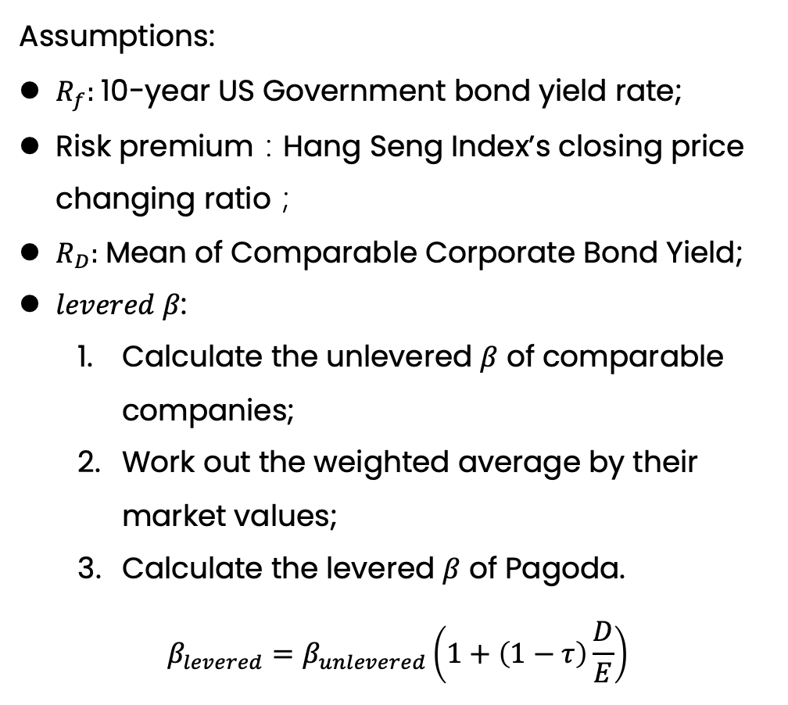

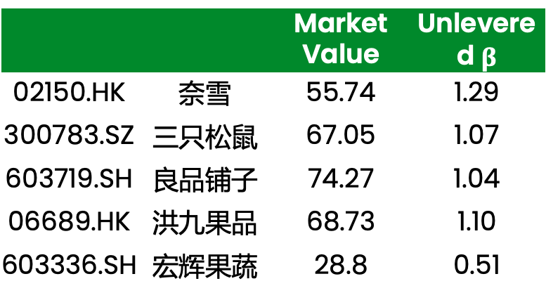
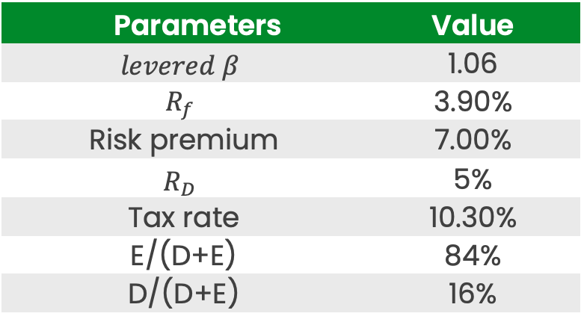
Market
Direct Method
Relative Method
Conclusion
Assumptions:
$R_{f}:$10-year US Government bond yield rate;
Risk premium：Hang Seng Index’s closing price changing ratio；
$R_{D}:$Mean of Comparable Corporate Bond Yield;
$levered β$:
Calculate the unlevered $β$ of comparable companies;
Work out the weighted average by their market values;
Calculate the levered $β$ of Pagoda.
$$β_{levered}=β_{unlevered}\left(1+\left(1−τ\right)\frac{D}{E}\right)$$
Table : Assumptions(%)
Parameters | Value
$$levered β$$ | 1.06
$$R_{f}$$ | 3.90%
Risk premium | 7.00%
$$R_{D}$$ | 5%
Tax rate | 10.30%
E/(D+E) | 84%
D/(D+E) | 16%
Table : Comparable $β$
 |  | Market Value | Unlevered $β$
02150.HK | 奈雪 | 55.74 | 1.29
300783.SZ | 三只松鼠 | 67.05 | 1.07
603719.SH | 良品铺子 | 74.27 | 1.04
06689.HK | 洪九果品 | 68.73 | 1.10
603336.SH | 宏辉果蔬 | 28.8 | 0.51

Slide 20
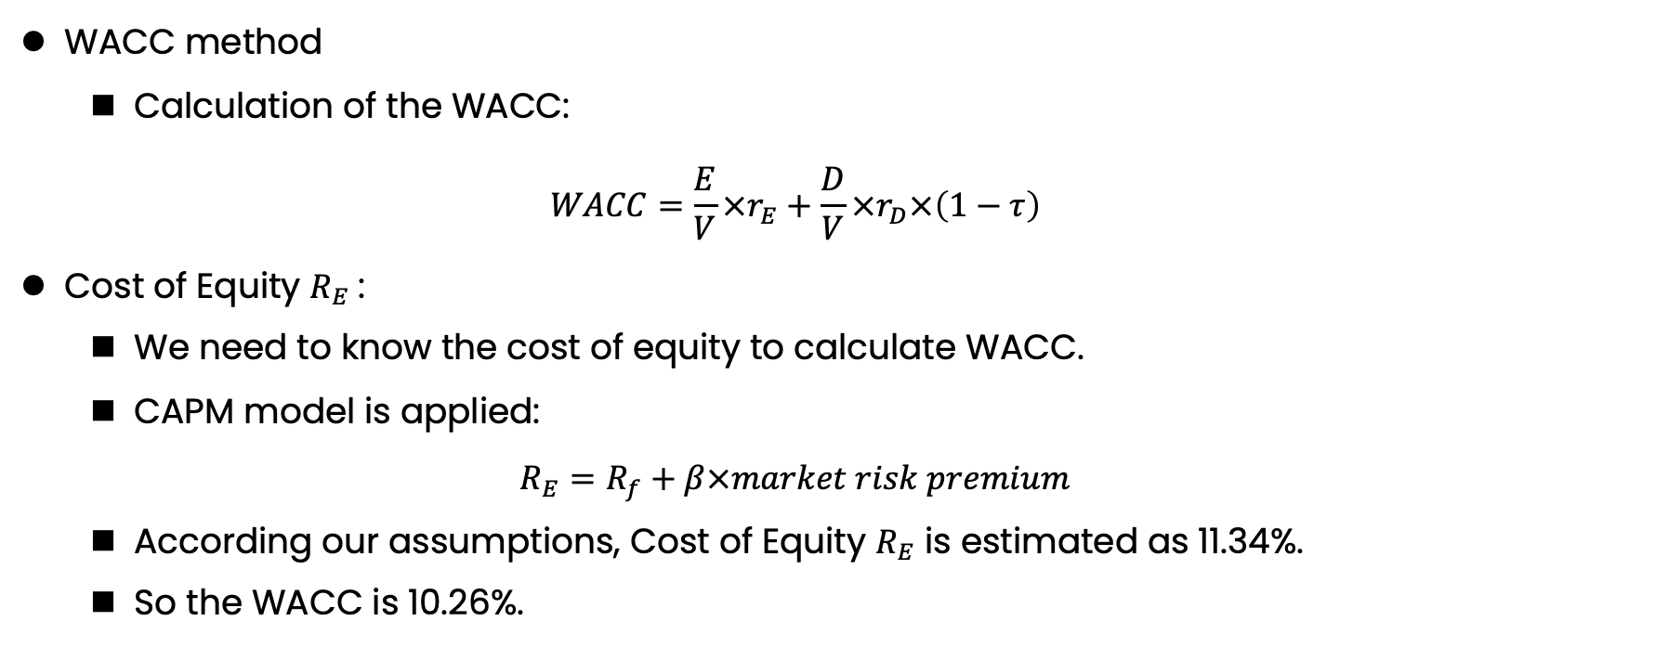
Market
Direct Method
Relative Method
Conclusion
WACC method
Calculation of the WACC:
$$WACC=\frac{E}{V}×r_{E}+\frac{D}{V}×r_{D}×\left(1−τ\right)$$
Cost of Equity $R_{E}$:
We need to know the cost of equity to calculate WACC.
CAPM model is applied:
$$R_{E}=R_{f}+β×market risk premium$$
According our assumptions, Cost of Equity $R_{E}$ is estimated as 11.34%.
So the WACC is 10.26%.

Slide 21
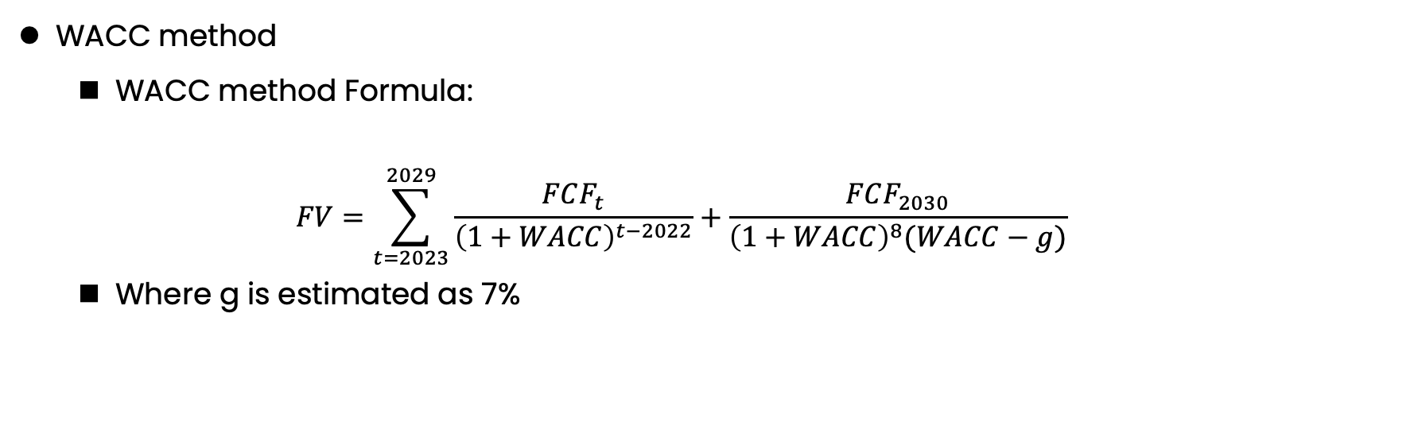
Market
Direct Method
Relative Method
Conclusion
WACC method
WACC method Formula:
$$FV=\sum_{t=2023}^{2029}{\frac{FCF_{t}}{{\left(1+WACC\right)}^{t−2022}}}+\frac{FCF_{2030}}{{\left(1+WACC\right)}^{8}(WACC−g)}$$
Where g is estimated as 7%
Table: WACC method(Million CNY)
 |  | 2021 | 2022 | 2023E | 2024E | 2025E | 2026E | 2027E | TV
FCFF |  |  | 210 | 279 | 379 | 395 | 456 | 782 | 25,657
PV(FCFF) |  | 0 | 173 | 208 | 256 | 242 | 254 | 395 | 12,948
Equity Value | 14475
Stock Value(CNY) | 12.24

Slide 22
Market
Direct Method
Relative Method
Conclusion
Table: Sensitive analysis(%)
 | WACC
Growth rate |  | 9.3% | 9.8% | 10.26% | 10.8% | 11.3%
 | 8.5% | 51.96 | 30.93 | 21.84 | 16.77 | 13.54
 | 8.0% | 31.78 | 22.44 | 17.23 | 13.91 | 11.61
 | 7.5% | 23.05 | 17.69 | 14.28 | 11.92 | 10.19
 | 7.0% | 18.18 | 14.67 | 12.24 | 10.46 | 9.10
 | 6.5% | 15.07 | 12.57 | 10.74 | 9.34 | 8.24
 | 6.0% | 12.91 | 11.03 | 9.59 | 8.46 | 7.55
 | 5.5% | 11.33 | 9.85 | 8.69 | 7.75 | 6.97

Slide 23
Market
Direct Method
Relative Method
Conclusion
Code | Company | Market Value (Billion) | Stock Price | Compound Growth Rate | PE
 |  |  |  |  | 2022A | 2023E | 2024E
06689.HK | 洪九果品 | 44.9 | 32.0 | 26.1% | 33.6 | 15.3 | 4.8
09896.HK | 名创优品 | 26.5 | 10.6 | 20.6% | 26.7 | 30.4 | 24.3
603719.SH | 良品铺子 | 14.6 | 36.5 | 5.1% | 58.3 | 21.2 | 17.3
603939.SH | 益丰药房 | 45.6 | 45.2 | 23.4% | 45.4 | 28.1 | 22.6
002557.SZ | 洽洽食品 | 26.4 | 48.8 | 11.0% | 32.8 | 30.8 | 24.5
Methods | 2022A | 2023E | 2024E
Min | 26.7 | 15.3 | 4.8
Max | 58.3 | 30.8 | 24.5
Average | 38.1 | 22.9 | 16.7
百果园集团 | 34.3 | 27.7 | 24.0
Table: P/E Valuation
Note: Liquidity discount: 10%

Slide 24
Market
Direct Method
Relative Method
Conclusion
Table: Valuation results
 | 2022A | 2023E | 2024E
Net Income | 306 | 341 | 396
Shares Outstanding | 1500 | 1500 | 1500
EPS | 0.20 | 0.23 | 0.26
PE | 34.3 | 27.7 | 24.0
Price | 6.9 | 6.4

Slide 25
Market
Direct Method
Relative Method
Conclusion
Pagoda stock price is underestimated in IPO and has great potential to increase
 | 2023E
Stock Price(2024-1-10) | 5.5
Stock Value(WACC) | 12.24
Stock Value(PE) | 6.4
Price(Average) | 9.32

Slide 26
Market
Direct Method
Relative Method
Conclusion
Why did this IPO happen in 2023?
Because Pagoda wants to expand its store amount.
Why did it happen at that time and not earlier or later?
Before 2023, Pagoda experienced a lot of scandals which stop it from IPO.
What were the gains and losses of all possible parties related to the event?
Investors: gain from the IPO
Managers: suffer a mild loss
Consumers: benefit from more stores and fruits
Did the management represent shareholders’ interest?
In 2023, there is a 0.1 billion (out of 97 billion) shareholders‘ reduction. So the majority of shareholders are happy with the management.

Slide 27
Market
Direct Method
Relative Method
Conclusion
Do you think this is a good or bad deal from the existing/new investors’ perspective?
In general , it is good for both sides. Because existing investors benefit from expansion and new investors buy cheaper stock.
Do you think the transaction price is fair?
The transaction price is a little bit underestimated but not biased very severely.
Can you think of a trading strategy to profit from this deal?
All in!

Slide 28

Q & A

